Slide 1
Attrition Study
DS6306 Case Study 2

Slide 2
Introduction
Top 3 Attrition Factors
Job Role Trend
Points System
Model Accuracy to Predict Attrition
Model Accuracy to Predict Salary

Slide 3
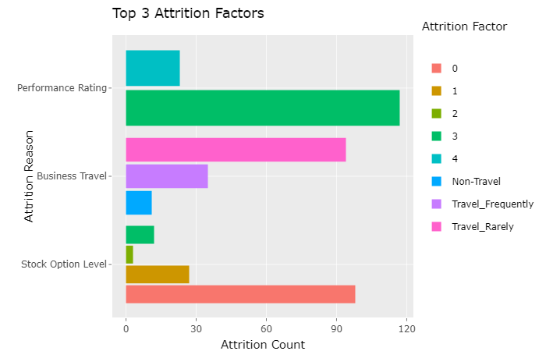
Top 3 Attrition Factors

Slide 4
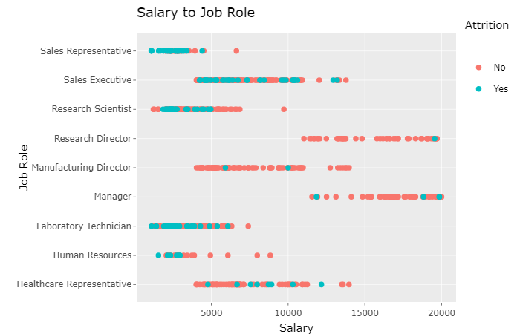
Education | JobRole | count
1 | Research Scientist | 16
2 | Research Scientist | 30
3 | Research Scientist | 78
4 | Research Scientist | 44
5 | Research Scientist | 4

Slide 5
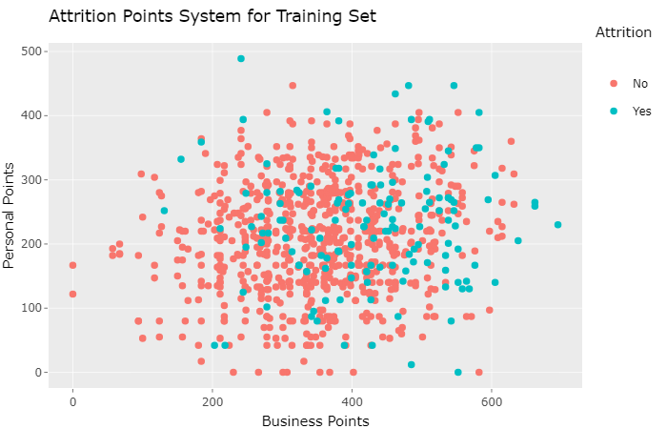
Points System
The top 20 factors
10 are assigned Personal Points and 10 are assigned Business Points.
The points are given based on the count of 'Yes'. Factors with more counts of 'Yes' rank higher.
Personal Points
Reason | Factor | Num 'Yes'
Gender | Male | 87
WorkLifeBalance | | 3 | 80
MaritalStatus | Single | 70
NumCompaniesWorked | 1 | 60
Education | 3 | 55
EducationField | Life Sciences | 53
EnvironmentSatisfaction | 1 | 42
RelationshipSatisfaction | | 4 | 42
DistanceFromHome | 1 | 17
Age | 29 | 12
Business Points Reason | Factor | Num ‘Yes’
PerformanceRating | 3 | 117
StockOptionLevel | 0 | 98
BusinessTravel | Travel_Rarely | 94
JobLevel | 1 | 86
OverTime | Yes | 80
Department | Research & Development | 75
JobInvolvement | 3 | 67
YearsSinceLastPromotion | 0 | 63
TrainingTimesLastYear | 2 | 57
JobRole | Sales Executive or Research Scientist | 33

Slide 6
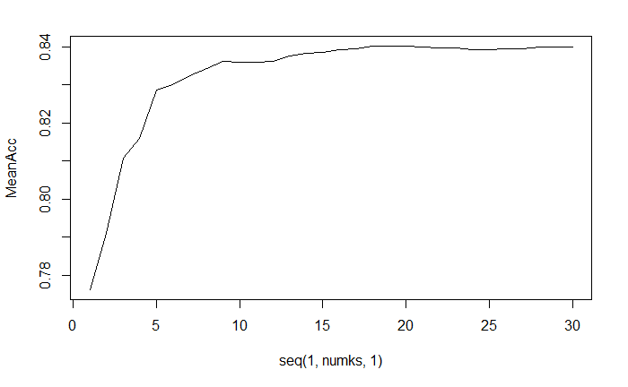
Model Accuracy
Classifications No Yes
Actual No 207 33
Actual Yes 15 6
Confusion Matrix and Statistics
Accuracy : 0.8161
When it's actually no, how often does it predict no?
Sensitivity : 0.9324
When it's actually yes, how often does it predict yes?
Specificity : 0.1538
MeanAcc is mean or average accuracy. K is the number of points used to decide yes or no.
We set k to a value that gets the best prediction.

Slide 7
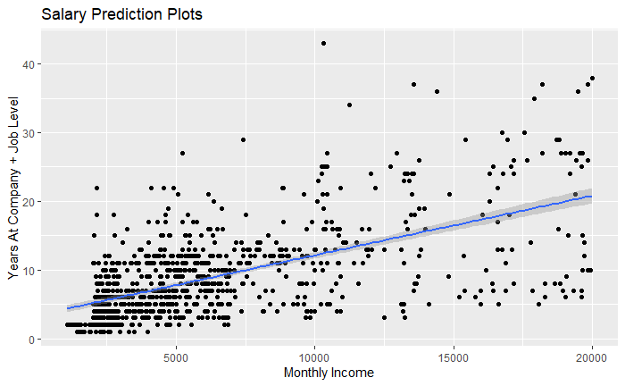
Salary Prediction
Residual standard error: 1414 on 867 degrees of freedom
Smaller residuals mean the predictions were better
Used Years at Company + Job Level vs Monthly Income to train the model.

Slide 8
Recap
Top 3 Attrition Factors
Job Role Trend
Points System
Model Accuracy to Predict Attrition
Model Accuracy to Predict Salary
https://github.com/cmdre94/CaseStudy2DDS.git

